Slide 1
Support Vector Machine
A review of its theoretical foundation and a practical use case
Anton Georgescu
Principal Product Architect, TEMS
January 2020

Slide 2
AGENDA
What is Support Vector Machine
Hyperplane: linear vs non-linear separation
SVM and higher dimensionality transformation through kernel functions
Tuning SVM parameters
Mathematical foundation of SVM
Pros and cons of SVM
Practical uses of SVM
Practical example of classification prediction with Python
Demo
Conclusion

Slide 3
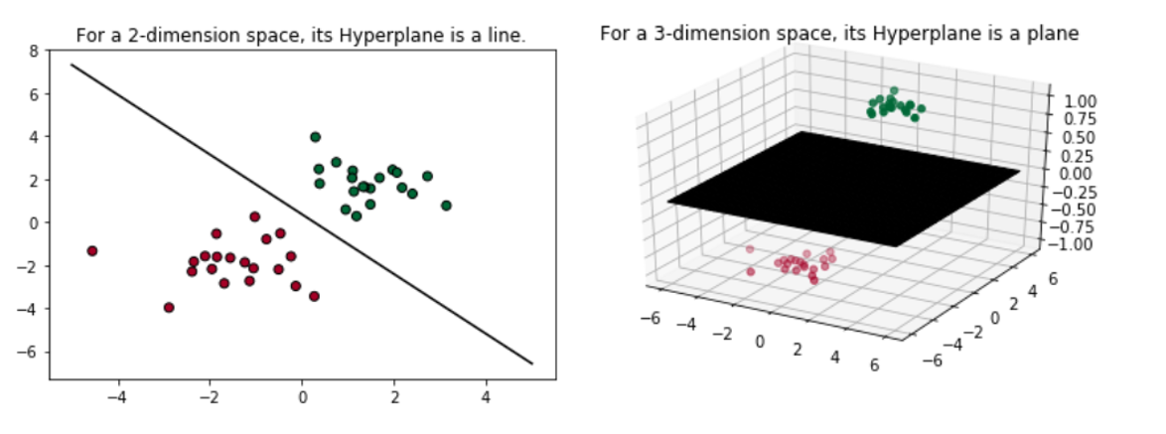
What is Support Vector Machine
SVM or Support Vector Machine is a linear model for classification and regression problems. It can solve linear and non-linear problems and work well for many practical problems.
The idea of SVM is simple: the algorithm creates a line or a hyperplane which separates the data into classes.
A hyperplane is a N-1 dimensional subspace for an N-dimensional space, that divides the space into two disconnected parts
For a 2-dimension space, its hyperplane will be 1-dimension, which is just a line.
For a 3-dimension space, its hyperplane will be 2-dimension, which is a plane that slice the cube

Slide 4
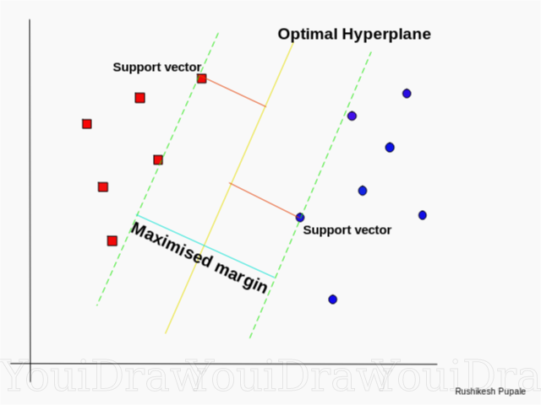
SVM with linear separation
Support Vector Machine (SVM) is an algorithm responsible for finding the decision boundary (the points) to separate different classes and maximize the margin.
Margins are the (perpendicular) distances between the line and those dots closest to the line.
The points identified by SVM as being the closest to the separation boundary (yellow line) are called “support vectors.”
The goal of the algorithm is to maximize the margin
The hyperplane for which the margin is maximum is the optimal hyperplane.
The goal of SVM is to identify the optimal hyperplane

Slide 5
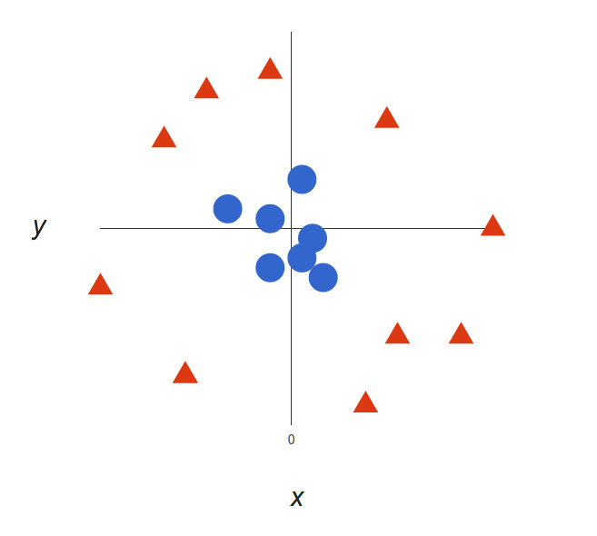
SVM when linear separation is not possible
The dataset in the image aside is not linearly separable.
We cannot draw a straight line that can classify this data.
However, this data can be converted to linearly separable data in higher dimension.

Slide 6
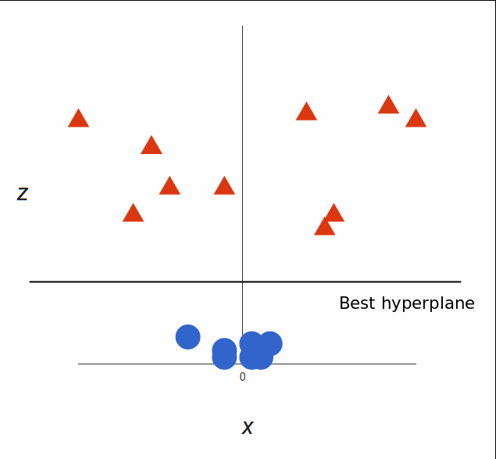
SVM when linear separation is not possible
Let the co-ordinates on z-axis be governed by the constraint,
z = x²+y²
So, basically z co-ordinate is the square of distance of the point from origin.
Now the data is clearly linearly separable.

Slide 7
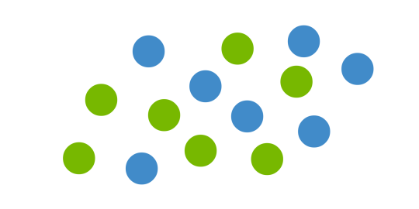
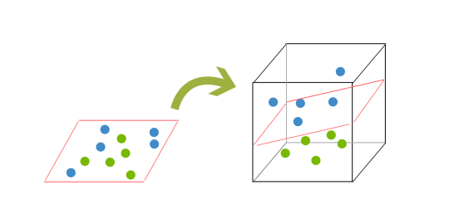
SVM Kernelling – An intuitive example
In order to classify a dataset like the one below (left side) it’s necessary to move away from a 2d view of the data to a 3d view.
Explaining this is easiest with another simplified example: imagine that our two sets of colored balls above are sitting on a sheet and this sheet is lifted suddenly, launching the balls into the air.
While the balls are up in the air, you use the sheet to separate them.
This ‘lifting’ of the balls represents the mapping of data into a higher dimension. This is known as kernelling

Slide 8
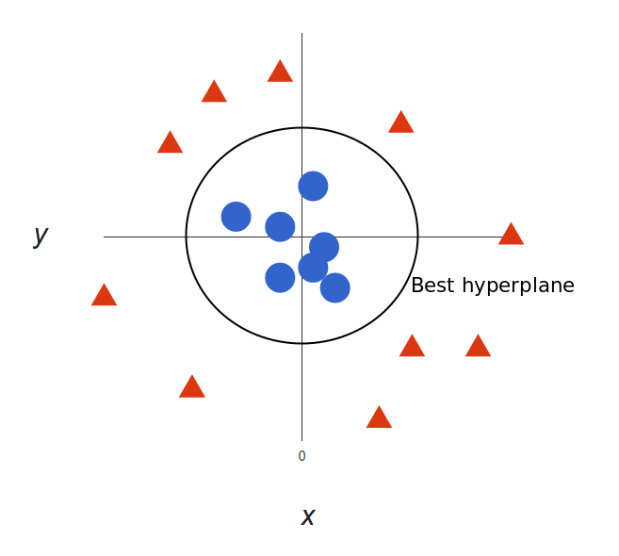
SVM when linear separation is not possible (cont’d)
Now let the purple line separating the data in higher dimension be z=k, where k is a constant.
Since, z=x²+y² we get x² + y² = k; which is an equation of a circle.
So, we can project this linear separator in higher dimension back in original dimensions using this transformation.

Slide 9
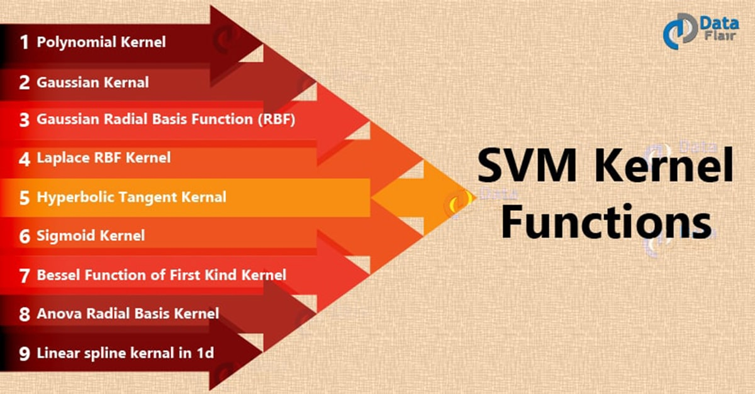
SVM and Kernel Functions
Based on the previous demo we can classify data by adding an extra dimension to it so that it becomes linearly separable and then projecting the decision boundary back to original dimensions using mathematical transformation.
However finding the correct transformation for any given dataset isn’t that easy. To overcome the complexities, we can use kernels in Python’s SciKit Learn (sklearn) SVM implementation to do this job.
The function of kernel is to take data as input and transform it into the required form.
Different SVM algorithms use different types of kernel functions.
These functions can be different types. For example linear, nonlinear, polynomial, radial basis function (RBF), and sigmoid.

Slide 10
SVM and Kernel Functions (cont’d)
RBF is the most used type of kernel function
RBF has localized and finite response along the entire x-axis.
Linear splines kernel in one-dimension is another popular kernel function.
It is useful when dealing with large sparse data vectors.
It is often used in text categorization.
The splines kernel also performs well in regression problems.
In our Demo later on we will use both these kernel functions

Slide 11
Tuning SVM Parameters
Parameters are arguments that you pass when you create your classifier. Following are the important parameters for SVM:
C
Also called “regularization parameter”
It controls the trade off between smooth decision boundary and classifying training points correctly.
A large value of C means you will get more training points correctly.
Gamma
It defines how far the influence of a single training example reaches. If it has a low value it means that every point has a far reach and conversely high value of gamma means that every point has close reach.

Slide 12
Mathematical Foundation of SVM
At its core Support Vector Machine comes with a “hyperplane optimization problem”
From a mathematical standpoint, there are two ways to solve this problem
Hard Margin SVM
it implements the Lagrange problem
hard margins result in fitting of a model that allows zero errors.
forcing rigid margins can result in a model that performs perfectly in the training set, but is possibly over-fit / less generalizable when applied to a new dataset.
Soft Margin SVM
the allowance of softness in margins allows for errors to be made while fitting the model (support vectors) to the training/discovery data set.
Many times it can be helpful to allow for errors in the training set, because it may produce a more generalizable model when applied to new datasets.

Slide 13
Pros and Cons of Support Vector Machine
Pros
Accuracy
Works well on smaller cleaner datasets
High Dimensionality: SVM is an effective tool in high-dimensional spaces, which is particularly applicable to document classification and sentiment analysis where the dimensionality can be extremely large.
Memory Efficiency: Since only a subset of the training points are used in the actual decision process of assigning new members, just these points need to be stored in memory (and calculated upon) when making decisions.
Versatility: Class separation is often highly non-linear. The ability to apply new kernels allows substantial flexibility for the decision boundaries, leading to greater classification performance.
Cons
Might not be suited for larger datasets as the training time with SVMs can be high
Less effective on noisier datasets with overlapping classes
Kernel Parameters Selection: SVMs are very sensitive to the choice of the kernel parameters. In situations where the number of features for each object exceeds the number of training data samples, SVMs can perform poorly.
Non-Probabilistic: Since the classifier works by placing objects above and below a classifying hyperplane, there is no direct probabilistic interpretation for group membership. However, one potential metric to determine the "effectiveness" of the classification is how far from the decision boundary the new point is.

Slide 14
Pros and Cons of Support Vector Machine
Pros
Accuracy
Works well on smaller cleaner datasets
It can be more efficient because it uses a subset of training points
High Dimensionality: SVM is an effective tool in high-dimensional spaces, which is particularly applicable to document classification and sentiment analysis where the dimensionality can be extremely large.
Memory Efficiency: Since only a subset of the training points are used in the actual decision process of assigning new members, just these points need to be stored in memory (and calculated upon) when making decisions.
Cons
Isn’t suited to larger datasets as the training time with SVMs can be high
Less effective on noisier datasets with overlapping classes

Slide 15
Support Vector Machine Uses
SVM is used for text classification tasks such as
category assignment
detecting spam
sentiment analysis.
SVM is also commonly used for image recognition challenges, performing particularly well in aspect-based recognition and color-based classification.
SVM also plays a vital role in many areas of handwritten digit recognition, such as postal automation services.

Slide 16
Demo
The code under https://github.com/antongeorgescu/machine-learning-documentation

Slide 17
Other Technologies that Support SVM
Python scikit-learn packages
Accord.NET Framework (NuGet)
LibSVM (Nuget)
Machine Learning Studio (part of Azure cloud offering)
IBM Watson (part of IBM cloud offering)
R svm organic functions (Linear & Non-linear SVM Classifier)
etc.

Slide 18
Thank you
anton.georgescu@finastra.com

